Slide 1
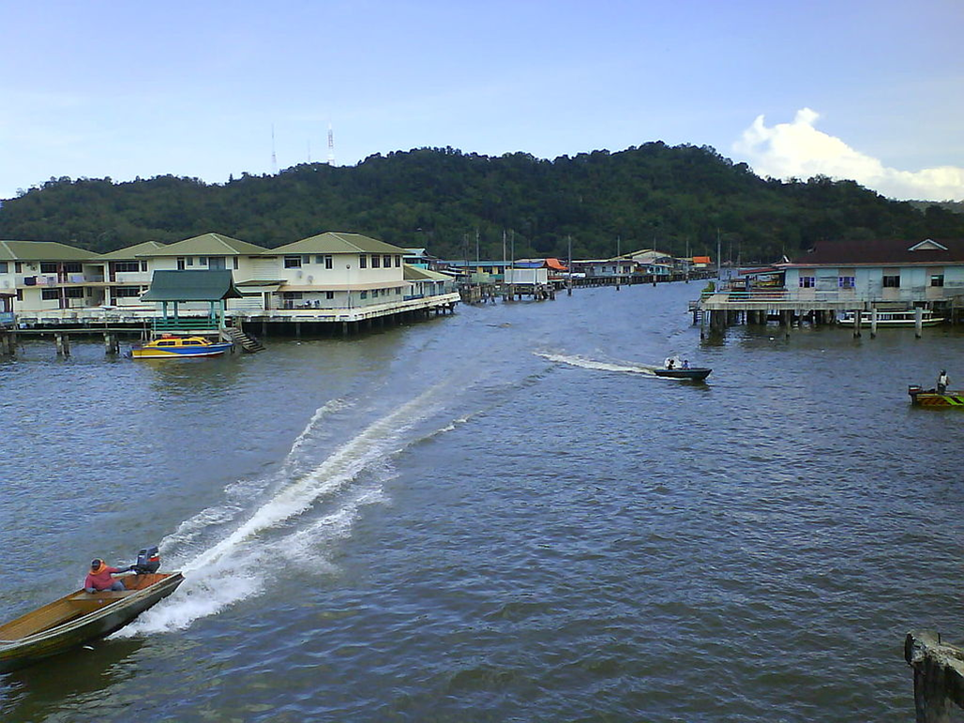
Why would these types of houses be vulnerable in a tropical storm?
Image place in the public domain by Kurun under the Creative Commons Attribution-ShareAlike 3.0 License

