Slide 1
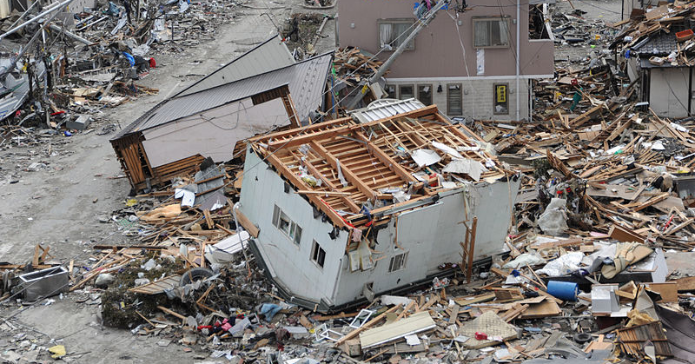
How severe are Japan's Earthquakes?
Starter:
Use this diagram to write five sentences describing the picture below.
What caption would you give this picture?
Notes:
Earthquake and tsunami damage in Ofunato, Japan, 2011 Image used courtesy of United States Navy
www.navy.mil/view_image.asp?id=98447

Slide 2
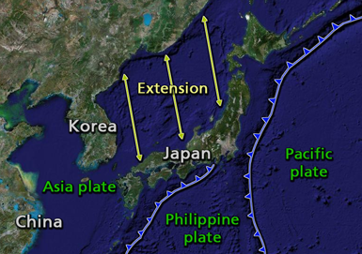
How severe are Japan's Earthquakes?
Japan is located in an area where several continental and oceanic plates meet. These cause frequent earthquakes, volcanoes and hot springs across Japan. They can also result in tsunamis (tidal waves).
Notes:
Map used courtesy of Oghmoir at the English language Wikipedia

Slide 3
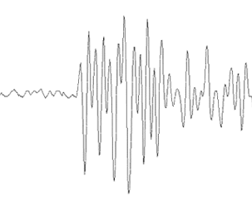
How does the Richter scale measure earthquakes?
The Richter scale measures the magnitude of an earthquake. The magnitude is the amount of energy released.
A seismograph measures the amount of shaking during an earthquake.
Seismographs record a zig-zag trace that shows the vibrations or oscillations in the ground beneath the instrument
Seismograph stations are found in many places all around Japan and the rest of the world.
The most sensitive seismographs can pick up vibrations from earthquake many thousands of kilometres away.
Notes:
Seismogram uses courtesy of the US Geological Survey

Slide 4
The Richter scale
Magnitude | Description | Average earthquake effects
Less than 2.0 | Micro | Can be detected only by a seismograph.
2.0–2.9 | Minor | Felt slightly by some people. No damage to buildings.
3.0–3.9 |  | Rarely causes damage. Shaking of indoor objects can be noticeable. Similar to the vibrations caused by a passing truck.
4.0–4.9 | Light | Felt by most people in the affected area. May break windows.
5.0–5.9 | Moderate | Furniture moves. Plaster may fall from walls. Can cause damage to poorly constructed buildings.
6.0–6.9 | Strong | Damage to some well-built structures in populated areas. Severe damage to poorly built structures.
7.0–7.9 | Major | Causes damage to most buildings and severe damage to poorly built structures.
8.0–8.9 | Great | Major damage to buildings with few structures left standing. Bridges destroyed.
9.0 and greater |  | At or near total destruction. Severe damage or collapse of all buildings.
Notes:
Provide students with a copy of the Richter for their exercise books, they will need to refer to this later.

Slide 5
Earthquakes every year!
The US Geological Survey estimates that several million earthquakes occur in the world every year. Many go undetected because they hit remote areas or have very small magnitudes. They now locate about 50 earthquakes each day, or about 20,000 a year.
The table below shows on average, globally, the number of moderate to severe earthquakes we can expect at each magnitude:
Magnitude | Average Annually
8 and higher | 1
7 - 7.9 | 15
6 - 6.9 | 134
5 - 5.9 | 1319
4 - 4.9 | 13,000 (estimated)
3 - 3.9 | 130,000 (estimated)
2 - 2.9 | 1,300,000 (estimated)

Slide 6
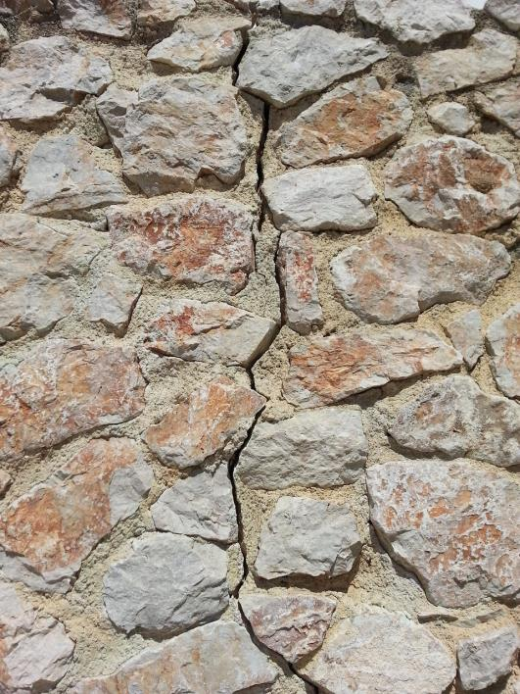
Recording the strength of recent earthquakes in Japan
In pairs, use the http://www.jma.go.jp/en/quake/ web site to complete an earthquake data table for the last 20 recorded earthquakes.
For each earthquake note down the date, magnitude & the regions/prefecture which it struck.
Use the tabs at the top of the map - 'previous information' to go back in time to record previous earthquakes, starting with the most recent.

Slide 7
Table to show the magnitude and locations of recent earthquakes in Japan
Date | Location | Magnitude
The mean magnitude was .................
The median magnitude was ....................
The mode was ................................
The range was .................... to .....................

Slide 8
Analysing the strength of recent earthquake events in Japan
Use your worksheet to calculate the mean, median, mode and range of recent earthquake events in Japan. This will build a picture of the average earthquake event.
The range is the difference between the largest and smallest values.
The median is the middle value. Re-write your list in ascending order to find the middle value.
The mode is the number that is repeated more often than any other
The mean is the average number.

Slide 9
Worked example of mean, median, mode, & range
Date | Location | Magnitude
8 Nov 2015 | Gifu-ken Hida-chiho | 3.4
8 Nov 2015 | Miyagi-ken Oki | 3.8
8 Nov 2015 | Bungo-suido | 3.2
7 Nov 2015 | Ibaraki-ken Nambu | 4.9
7 Nov 2015 | Kushiro Oki | 3.9
7 Nov 2015 | Fukushima-ken Nakadori | 2.9
7 Nov 2015 | Chiba-ken Toho-oki | 3.2
Mean ( average) - 3.4+3.8+3.2+4.9+3.9+2.9+3.2 = 25.3 = 25.3/7 = 3.6 magnitude
Median - (values written low to high) - 2.9, 3.2, 3.2, 3.4, 3.8, 3.9, 4.9 = 3.4 magnitude
Mode is a 3.2 magnitude ( it appears twice in the list, the others only appear once)
Range - ( highest value minus the lowest) = 4.9 - 3.2 = 1.7 magnitude

Slide 10
Extension
For the highest magnitude earthquake event on your table, use the internet to research the impacts in that area.
Remember to include social, economic and environmental impacts!
Make notes on the impacts in your books under a suitable heading e.g.. 'Impacts of the 5.8 earthquake in Fukashima'
If there are few details to be found, try to find out other specific information on this earthquake (focus, nearby towns/villages effected, exact time of earthquake, fault line name etc.)

Slide 11
In your books, write a summary on the locations and strengths of the earthquakes you have researched in your enquiry. Use the grid below to plan to meet your target grade on this piece of work.
Homework: Recent Japanese Earthquakes - mini report
Difficulty | Included
 | Names of places that have experienced earthquakes. Brief description of data from the table. Describes overall trends in a basic way.
 | Refers to some averages, such as mean, median, mode and range to describe data. Begins to use keywords, e.g. epicentre, fault line, magnitude, seismic energy, Richter scale etc.
 | Describes patterns in locations and earthquake intensity in detail using statistics. Refers to a wide range of keywords and uses independent research to give examples of the impacts felt for the stronger earthquakes.
 | All of the above with a high level of SPaG and logical written structure. Explains in detail why earthquakes have hit these areas, extensive independent research on causes and impacts of the strongest earthquake measured.

