Slide 1
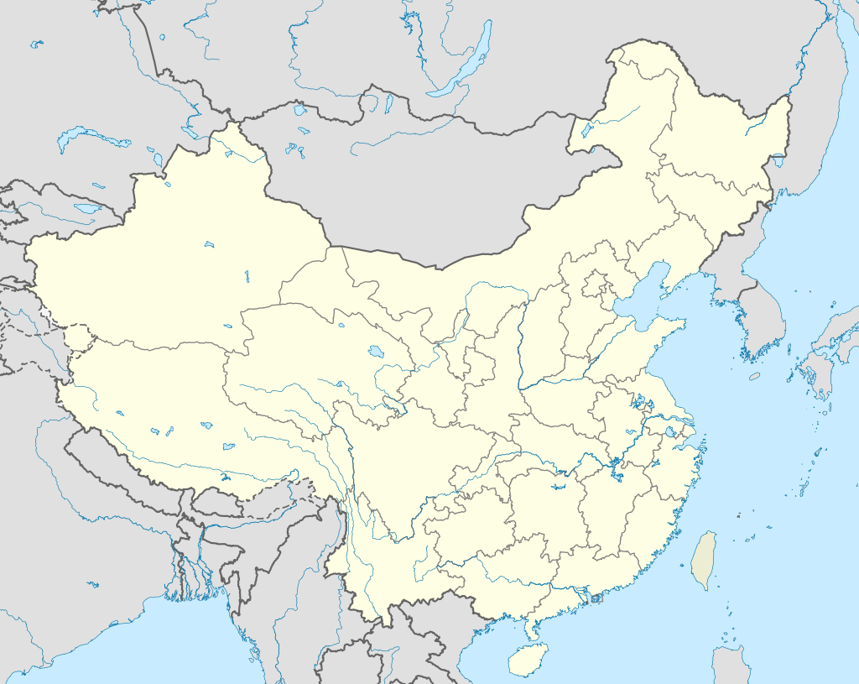
Urban Growth
Shenzhen is located in the Pearl River Delta of south-eastern China, bordering Hong Kong to the south.
In 1950, the small fishing village of Shenzhen in south-east China had 3,148 inhabitants.
Notes:
Map used courtesy of Uwe Dedering, 2010 under a CC BY-SA 3.0 licence:
en.wikipedia.org/wiki/Shenzhen#/media/File:China_edcp_location_map.svg

Slide 2
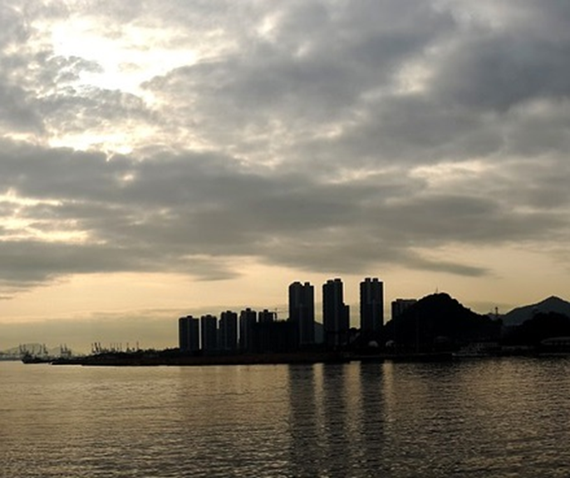
Urban Growth
Shenzhen is located in the Pearl River Delta of south-eastern China, bordering Hong Kong to the south.
In 1950, the small fishing village of Shenzhen in south-east China had 3,148 inhabitants.
In 1995, the population had grown to 2.39 million!
Notes:
This image is in the public domain and freely available at pixabay.com/en/early-stuff-li-wu-shenzhen-617022/

Slide 3
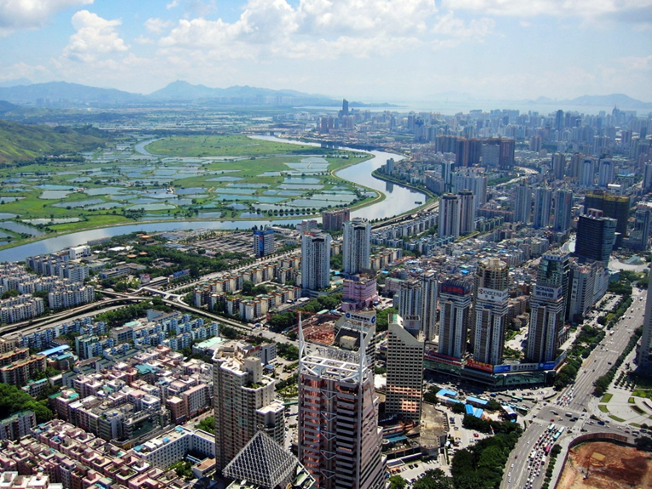
Urban Growth
Shenzhen is located in the Pearl River Delta of south-eastern China, bordering Hong Kong to the south.
In 1950, the small fishing village of Shenzhen in south-east China had 3,148 inhabitants.
In 1995, the population had grown to 2.39 million!
In 2000, it was 6.55 million.
Notes:
Image used courtesy of SSDPenguin, 2011 under a CC BY-SA 3.0 licence:
commons.wikimedia.org/wiki/File:Shenzhen_CBD_and_River.jpg

Slide 4
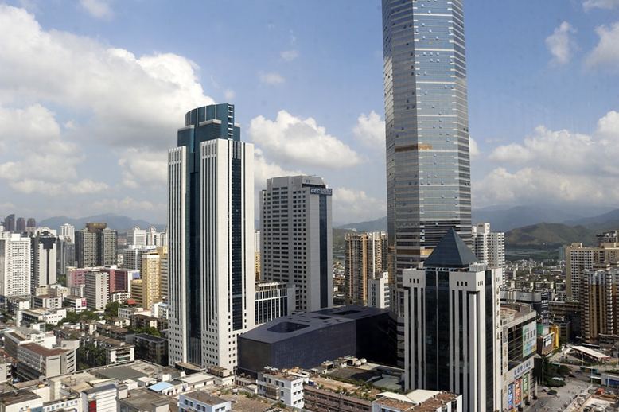
Urban Growth
Shenzhen is located in the Pearl River Delta of south-eastern China, bordering Hong Kong to the south.
In 1950, the small fishing village of Shenzhen in south-east China had 3,148 inhabitants.
In 1995, the population had grown to 2.39 million!
In 2000, it was 6.55 million.
By 2025, the UN predicts, that number will exceed 12 million!
Notes:
This image is in the public domain and freely available at pixabay.com/en/shenzhen-building-model-818817/

Slide 5
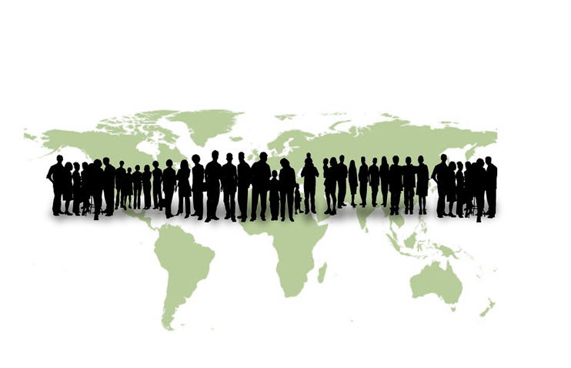
Urban Growth
The rapid urban growth of Shenzhen is unusual but it is not unique.
A useful way of understanding urban growth is to investigate the increase in the number of people every hour in selected cities.
Notes:
This image is in the public domain and freely available at pixabay.com/en/humanity-earth-globe-world-human-254788/

Slide 6
Urban growth per hour
City | Increase (in people per hour)
Berlin | 1
Delhi | 79
Dhaka | 74
Hong Kong | 4
Istanbul | 19
Jakarta | 27
Johannesburg | 2
Kinshasa | 63
Kolkata | 32
Lagos | 85
London | 9
Manila | 29
Mexico City | 22
Mumbai | 51
New York | 10
Rio de Janeiro | 10
Sao Paulo | 18
Shanghai | 53
Shenzhen | 15
Tokyo | -1

Slide 7
A few questions…
Which cities are experiencing the greatest urban growth?
How does Jakarta compare with the other cities listed?
What is happening in Tokyo?
Does urban growth appear to be concentrated in a particular part of the world?

Slide 8
Urban growth does appear to be concentrated in areas of the world!
Urban growth per hour
Continent | Number of cities
North America | 1
South America | 3
Europe | 2
Africa | 3
Asia | 11
Oceania | 0
Antarctica | 0

