Slide 1
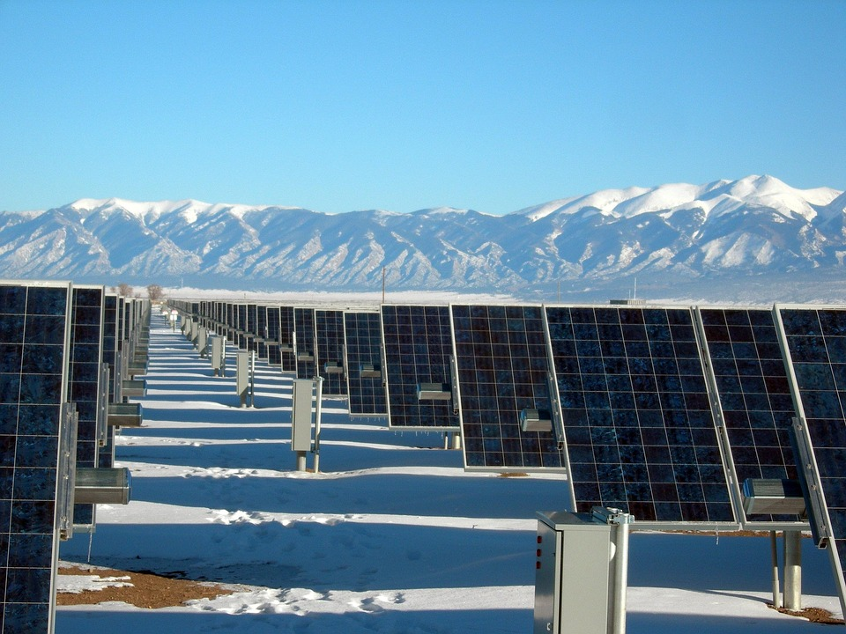
Sustainability matching activity

Slide 2
Sustainable
Minimising damage to the environment and avoiding using natural resources, e.g. by using renewable resources.

Slide 3
Non-renewable resources
Resources that cannot be replaced once they have been used up, e.g. coal, oil and natural gas.

Slide 4
Renewable resources
Resources that are generated from sources that are not finite or exhaustible, e.g. wave power, wind power and solar power.

Slide 5
Brownfield site
An area of derelict urban land that has previously been built upon.

Slide 6
Congestion charge
A payment that has to be made if a vehicle drives in a designated area during certain times of the week.

Slide 7
Carbon footprint
The amount of energy generated from the activities of people.

Slide 8
Recycling
The process of using a material more than once, e.g. a glass bottle can be melted down and re-formed into a jam jar.

Slide 9
Global warming
The rise in the average temperature of the Earth’s surface.

Slide 10
Fossil fuels
Fuels, such as coal, oil and natural burned to produce energy. They are formed from the remains of animals and plants from millions of years ago.

Slide 11
Greenhouse gases
Naturally occurring gases, e.g. carbon dioxide, methane and nitrous oxide. These are thought to have increased due to the burning of fossil fuels.

Slide 12
Green electricity
Electricity generated by a renewable method with a relatively low impact on the environment, e.g. wave, wind and solar power.

Slide 13
Regeneration
Growth in areas that have experienced decline in the past.

Slide 14
Greenfield site
A piece of land that has not been built upon before, but is now being considered for development.

Slide 15
Economic development
The progress made by creating wealth through businesses, industry and trade.

Slide 16
Pollution
Contamination of the environment, usually by chemicals.

Slide 17
Smog
A mixture of smoke produced by factory or domestic emissions and fog.

