Slide 1
Global urbanisation
Urbanisation is the proportion or percentage of people living in towns and cities.
In 1800, only about 3% of the world’s population lived in urban areas.
In 1950, about 30% of the world’s population lived in urban areas.
In 2008, the UN estimated half of the world’s population lived in urban areas.
In 2014, 54% of the world’s population lived in urban areas.
In 2050, it is anticipated that 66% of the world’s population will be living in urban areas.
Notes:
This image is in the public domain and freely available at pixabay.com/en/building-windows-orange-urban-984454/

Slide 2
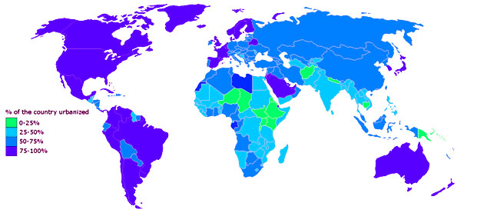
Global urbanisation
Notes:
Map used courtesy of Rotterdamus1234, 2012 under a CC BY-SA 3.0 licence:
commons.wikimedia.org/wiki/File:Urbanisation-degree.png

