Slide 1
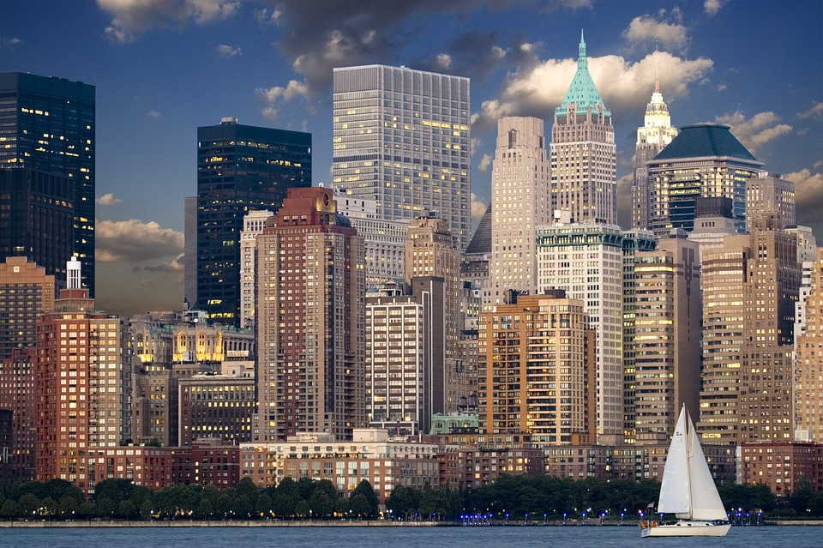
The growth of world cities
Notes:
Public Domain. Image free for commercial use. No attribution required.
pixabay.com/en/new-york-skyline-manhattan-hudson-540807/

Slide 2
Urbanisation is the proportion or percentage of people living in towns and cities.
In 1800, only about 3% of the world’s population lived in urban areas.
In 1950, about 30% of the world’s population lived in urban areas.
In 2008, the UN estimated half of the world’s population lived in urban areas.
Urbanisation has resulted in more and more, larger and larger cities around the world.

Slide 3
There has been a growth of very large cities with a population of more than 1 million.
In 1850, there were only 2 millionaire cities, namely London and Paris.
In 1950, there were 83 millionaire cities.
In 2015, there were approximately 500 millionaire cities.
Use a software application, such as Excel, to produce a bar graph to show how the number of millionaire cities has changed over time.

Slide 4
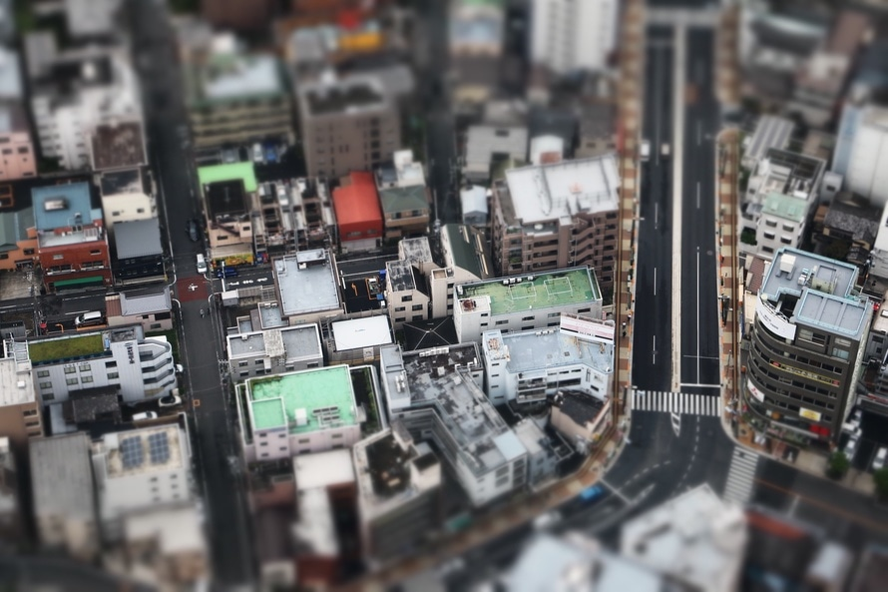
There has been a change in the location and distribution of millionaire cities:
Before 1950, many millionaire cities were found in MEDCs and temperate latitudes north of the Equator.
Research the names and locations of the world’s 15 largest cities of today.
Notes:
Public Domain. Image free for commercial use. No attribution required.
www.pexels.com/photo/aerail-view-of-city-buildings-24934/

Slide 5
The world now also has megacities. These are cities with a population in excess of 10 million.
In 1950, there were only three megacities in the world: London, New York and Tokyo.
In 2014, there were 28 megacities worldwide:
16 in Asia, 4 in South America, 3 each in Africa and Europe and 2 in North America.
By 2030, the world is projected to have 41 megacities.
Write a sentence to describe the changing location of the world’s megacities.

Slide 6
True or false?
There has been a change in the location and distribution of large cities since 1850.
In 1970, half of the world’s ten largest cities were found in the MEDCs of North America and Europe.
By 2000, 15 of the 19 world’s largest cities were found in the LEDCs of Africa, Asia and South America.
Since the 1970s, the growth rate of most cities in MEDCs has slowed down, or even declined.
Currently, the fastest growing cities are in Southern Asia.
T/F
T/F
T/F
T/F
T/F

