Slide 1
Gloucester Docks - 1981
Notes:
©Chris Allen geograph.org.uk/photo/1764218 and licensed for reuse under thisCreative Commons Licence

Slide 2
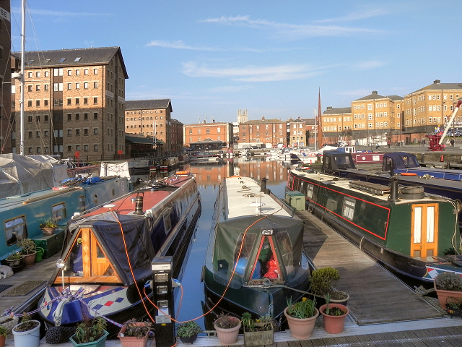
Gloucester Docks - 2012
Notes:
© Copyright David Dixon geograph.org.uk/reuse.php?id=2836475 and licensed for reuse under this Creative Commons Licence

