Slide 1
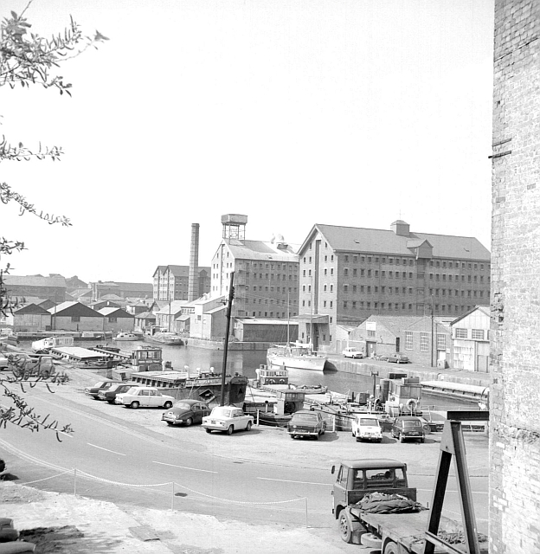
Image A
Notes:
© Copyright Alan Longbottom geograph.org.uk/reuse.php?id=396263 and licensed for reuse under this Creative Commons Licence

Slide 2
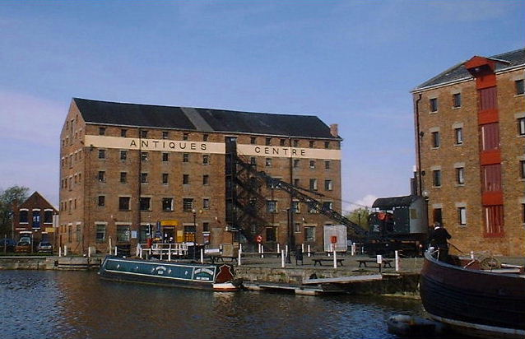
Image B
Notes:
© Copyright Paul Best geograph.org.uk/reuse.php?id=276404 and licensed for reuse under thisCreative Commons Licence

Slide 3
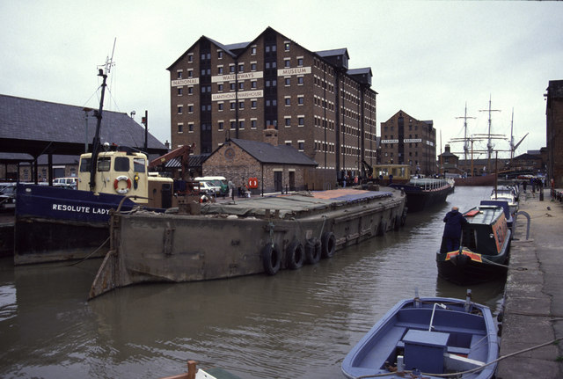
Image C
Notes:
© Copyright Chris Allen geograph.org.uk/reuse.php?id=621257and licensed for reuse under thisCreative Commons Licence

Slide 4
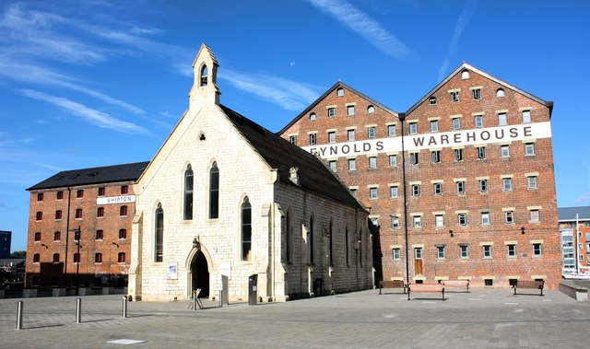
Image D
Notes:
© Copyright Colin Manton geograph.org.uk/reuse.php?id=2430182and licensed for reuse under this Creative Commons Licence

Slide 5
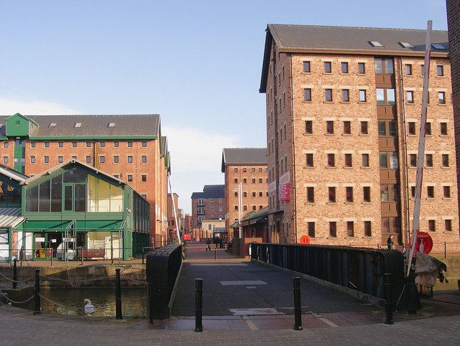
Image E
Notes:
© Copyright Philip Pankhurst geograph.org.uk/reuse.php?id=676710 and licensed for reuse under this Creative Commons Licence

Slide 6
Image F
Notes:
© Copyright Philip Pankhurst geograph.org.uk/reuse.php?id=4031575 and licensed for reuse under this Creative Commons Licence

Slide 7
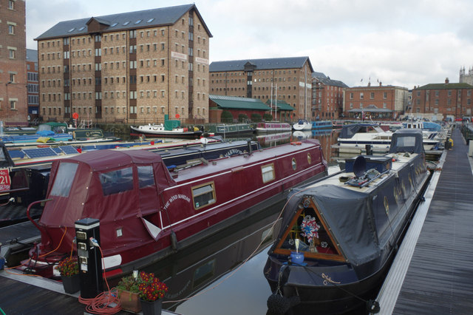
Image G
Notes:
© Copyright Stephen McKay geograph.org.uk/reuse.php?id=4260723 and licensed for reuse under this Creative Commons Licence

Slide 8
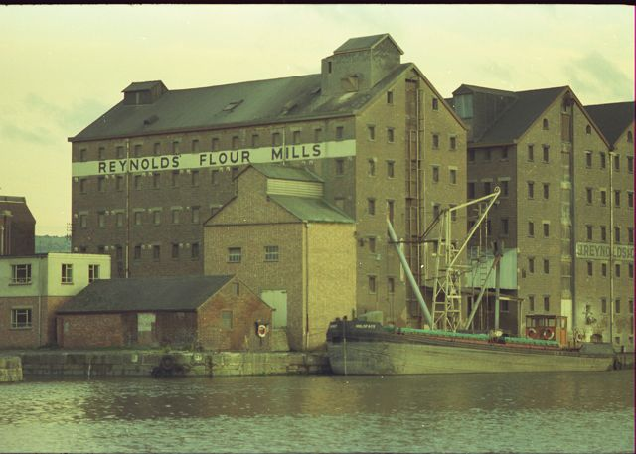
Image H
Notes:
© Copyright Peter Randall-Cook geograph.org.uk/reuse.php?id=2142674 and licensed for reuse under this Creative Commons Licence

